Slide 1


Social Relationships and Well-being During the COVID-19 Pandemic
Haroon Popal

Slide 2
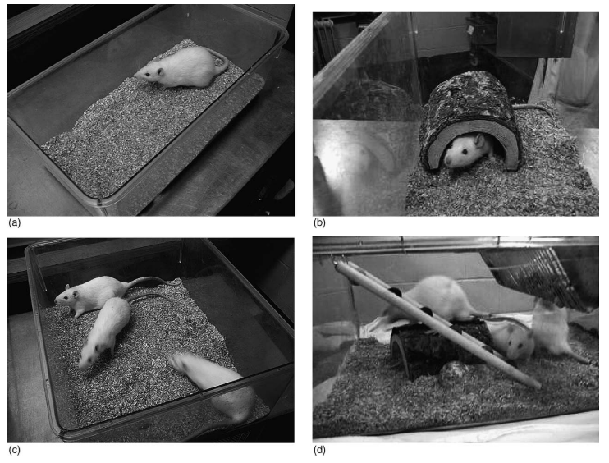

Environmental Enrichness (EE)
Physical EE
Social EE
Physical EE
Social EE
COVID-19
Social Distancing
Physical EE
Social EE
Physical EE
Social EE
Normal Life
Elliott & Grunberg, 2005 Behavioural Brain Research
Notes:
Environmental enrichness is a topic that comes up in rodent research and refers to a mouse’s availability to interact with objects in their environment.
EE in rodents has been shown to result in better task performance and plasticity

Slide 3
Social Relationships and Health
Social Isolation
Successful Aging
Depression
Cognitive Performance
Executive Functioning
(Cacioppo & Hawkley, 2009; DiNapoli et al., 2014)
Cognitive performance
Dementia
(Barnes et al., 2007; Yaffe et al., 2009; Fratiglioni et al., 2004
Notes:
Social relationships has been implicated in various health outcomes. Social isolation or a lack of social relationships has been shown to increase your chances of.
In older adults, it has been shown that those who were able to maintain strong social relationships later in life had…..

Slide 4
Hypotheses
Individuals who report increased time with relationships that they perceive to be negative will result in worse well-being
Certain categories of relationships, such as familial relationships, will be predictive of worse well-being

Slide 5
Proposed Path Analysis
Anxiety
Quality of Relationships
Behavioral/Emotional Control
Variety of Relationships
Well-Being
Depression
Calm Positive Affect
Number of Relationships
Happy Positive Affect
Notes:
Two latent factors: social distancing and well-being
Well-being will be predicted by the indicators of social distancing
Variety of relationships of relationships will be calculated by the types of relationships that individuals have (how many of the 159 from our list)
Quality of relationships can be derived from the valence of the relationships as reported by the participant, or by one of our components (formality)

Slide 6
Methods
Participants
768 Amazon Mechanical Turk (Mturk) participants → 728 after exclusions
Questionnaire (~ 15 mins)
Relationships questions about immediate network (people you live people) and extended network (people you interact with outside of your home)
Well-being questions from Mental Health Inventory (MHI-5) (Berwick et al., 1991)
Data Analysis
Well-being as a latent factor of anxiety, depression, emotional/behavioral control, calm positive affect, and happy positive affect
Three social variables as predictors (immediate network size, number of unique relationships, and immediate network time-weighted valence
Data preparation done with python
Structural equation modeling done in R with the lavaan package
Diagonally weighted least squares was used since our well-being variables were ordinal

Slide 7
 | Question | Abbreviation(s) | Item-level responses
Social | How many individuals live in your household, not including yourself? | Immediate network size (INS) | Numeric response
 | Please list the relationship that each individual in your household has with you and indicate the amount of time you have spent with them (in hours), during the past week. | unique_rels, w_{sn} | Numeric response for each relationship (i.e. mother: 40, father: 40, brother1: 60, brother2: 20)
 | Please list the relationship that each individual in your household has with you and indicate how positive or negative that relationship has been, during the past week | IN_rel_{xn}_val | Very positive: 5; Positive: 4; Neutral: 3; Negative: 2; Very negative: 1 Each relationship was given its own rating (i.e. mother: 3, father: 3, brother1: 5, brother1: 1)
Well-being (Wellb) | How much of the time, during the past week, have you been a nervous person? | anxiety | Much less than usual, Less than usual, About the same as usual, More than usual, Much more than usual
 | How much of the time, during the past week, have you felt calm and peaceful? | pos_affect_calm | Same as above
 | How much of the time, during the past week, have you felt downhearted and blue? | depression | Same as above
 | How much of the time, during the past week, have you been a happy person? | pos_affect_happy | Same as above
 | How much of the time, during the past week, have you felt so down in the dumps that nothing could cheer you up? | behav_emo_control | Same as above
IN_valw = IN_rel_{x1}_val*w_{x1} + IN_rel_{x2}_val*w _{x2} + IN_rel_{x3}_val*w_{x3} ... + IN_rel_{xn}_val*w_{xn}
Notes:
These are the questions from the questionnaire that are relevant to our model. We have social questions about how many people live in the participant’s home (INS), a question about how many different types of relationships that people interact with, and a measure about the valence of those relationships. This is calculated by the following formula, where each relationships is rated for valence, and then weighted based off of how much time they reported spending with a given relationships.
Next I have questions where the participant was asked to rate their level of anxiety, depression, behavioral emotional control, calmness and happiness during the past week.

Slide 8
Results
Notes:
These are the demographic of my sample. This is sample, although large, is not representative of the US general population, but it is pretty standard with what you get from mturik. Young, mostly white, educate people. One plus side is that the gender ration is even.

Slide 9
Model Fit
npar | 16.000
chisq | 115.593
df | 20.000
pvalue | 0.000
cfi | 0.917
tli | 0.883
rmsea | 0.101
rmsea.ci.lower | 0.083
rmsea.ci.upper | 0.119
rmsea.pvalue | 0.000
Notes:
First I will look at the fit of our model. The chi-square is significant, the CFI and TLI are low, the rmsea is high. So overall this is a bad fit. In the discussion I will address some things that I can do to try and make a better fit.

Slide 10
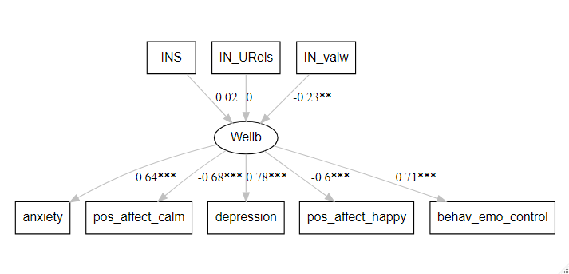
Path Analysis Results
Notes:
Ignoring our bad fit for a moment, here are the results of our path analysis. First, well-being was a latent factor significantly related to each of my 5 mental health items. Relationship valence was significantly predictive of our well-being latent factor, while immediate network size, and number of unique relationships was not. What this model is showing is that if you spend more time with negative relationships, that will be predictive of a higher well-being score, which in this model is related to higher levels of anxiety, depression, and behavioral/emotional control deficits, and lower levels of calmness and happiness.

Slide 11
Discussion
Model fit was poor, so we cannot rely on the results of this analysis
Not enough variance – people are not miserable enough at week 1
Poor measures of relationships
Need to account for nuisance variables
Physical EE
Health
boredom
Notes:
One reason may be because there was not enough variance with the well-being measures. This survey was done during the first week of when most of the nation was in lockdown, so perhaps people were still somewhat excited. Second, perhaps my measures of relationship features were not the right ones to look at. Third, I should probably add some nuisance variables to account for things that might also be affected well-being like, physical EE decreases, poor health, and boredom, which are not inherently related to social relationships.

Slide 12

Next Steps – Categorical Relationships
Quarantined with in-laws vs roommates
Family Relationship Features
Formality
Love
Privacy
Friend Relationship Features
Formality
Love
Privacy
Notes:
Two latent factors: social distancing and well-being
Well-being will be predicted by the indicators of social distancing
Variety of relationships of relationships will be calculated by the types of relationships that individuals have (how many of the 159 from our list)
Quality of relationships can be derived from the valence of the relationships as reported by the participant, or by one of our components (formality)

Slide 13

Next Steps – Longitudinal
Week 1
Week 4
Week 7
Notes:
Two latent factors: social distancing and well-being
Well-being will be predicted by the indicators of social distancing
Variety of relationships of relationships will be calculated by the types of relationships that individuals have (how many of the 159 from our list)
Quality of relationships can be derived from the valence of the relationships as reported by the participant, or by one of our components (formality)

Slide 14
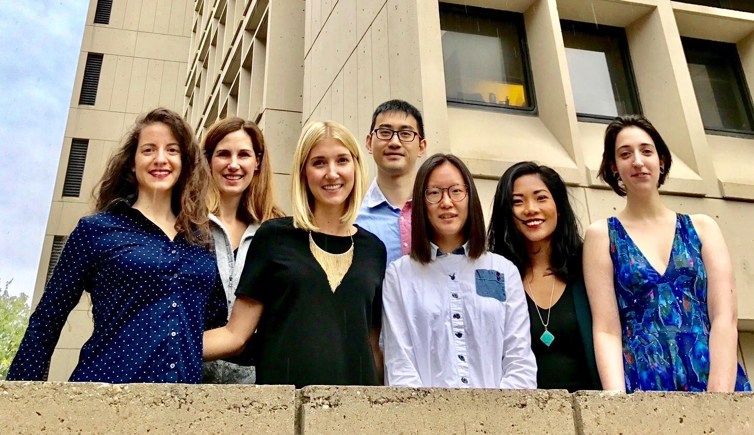
Acknowledgements
Thanks to:
Dr. Ingrid Olson
Dr. Yin Wang
Dr. Tom Olino
Olson Lab

Slide 15
COVID-19 Influence on Well-being
Dunbar, TICS, 2018
Notes:
From the perspective of Dunbar, 2018, who has done a lot of research on the evolutionary perspective of social relationships, well-being can be modeled based off of social relationships. When we compare this model to our current lives during the COVID-19 pandemic and social-distancing or quarantine measures, parts of this model are significantly impacted. the Covid-19 lockdown will decrease regular social eating, number of friends, community engagement, and trust in community. How will this impact the other variables in the model: life satisfaction, happiness, and life is worthwhile?

Slide 16

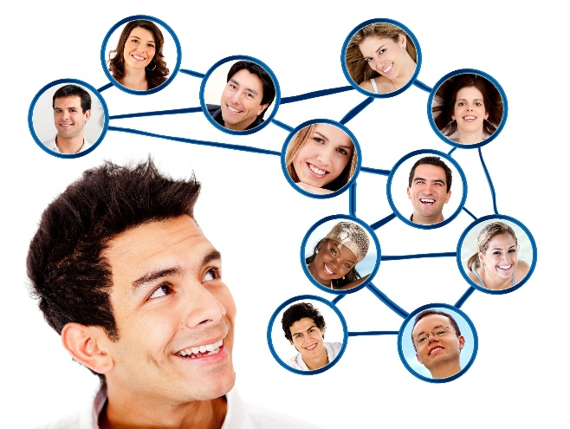
Importance of Social relationship
Personal Success, Physical Health, Mental Health and Well-being (Baumeister et al., 1995; Reis et al., 2000)
Notes:
Humans are able to experience a large variety of relationships – we have the ability to think about people and their relationship to us, but also the relationship between people.
This creates a network of relationships, of people in our lives. Having and maintain social relationships has been shown to be important for….
This has led to theories about the need to belong – social connections are a fundamental desire of humans (Baumeister & Leary, 1995). Relationships are what make us social. Every day, we go out and see people, we gossip about people, we read and watch movies about people and their relationships

Slide 17
Things Influenced by pandemic
Relationship
Well-being
Health
Physical Isolation (Physical EE)
Change in Relationships
No Entertainment
Uncertainty
Personal Goals/Development
Number of friends
Physical health
Variety of relationship
Mental health
Quality of relationship
Happiness
How much of interaction
RelationalHarmony
Way of interaction
Personal success
Content of interaction
Notes:
Health – physical, mental, cognitive
Physical isolation – lockdown, no travel, loss of freedom
Change in relationships – take care of kids, live with certain people for a long time
No entertainment – sports, concerts, cinemas, shopping
Uncertainty – work at home, online courses, how long
Personal goals/development – career, school (graduation), personal life (weddings)

Slide 18
Path Analysis Results
Dependent Variable | Operation | Independent Variable | β | SE | z | p
Wellb | =~ | anxiety | 0.64 | 0.05 | 13.67 | 0
Wellb | =~ | pos_affect_calm | -0.68 | 0.04 | -16.61 | 0
Wellb | =~ | depression | 0.78 | 0.04 | 21.14 | 0
Wellb | =~ | pos_affect_happy | -0.60 | 0.04 | -15.72 | 0
Wellb | =~ | behav_emo_control | 0.71 | 0.04 | 17.92 | 0
Wellb | ~~ | Wellb | 1.00 | 0.00 | NA | NA
Wellb | ~ | INS | 0.02 | 0.04 | 0.48 | 0.632
Wellb | ~ | IN_Urels | 0.00 | 0.51 | -0.07 | 0.941
Wellb | ~ | IN_valw | -0.23 | 0.72 | -3.24 | 0.001

